Slide 1

1st REVIEW Distributed Video Anomaly Detection in Large-Scale Surveillance Systems Using HDFS and Cluster-Visualized Federated CNN–LSTM Models
YALAMARTY SATHVIKI | 2520030059
RAMGARI RAGHUVEER | 2520030225
U. PRANEETH | 2520030188
Under the Guidance
of
Dr. S. Spandana
Assitant Professor
Department of Computer Science and Engineering
KONERU LAKSHMAIAH EDUCATION FOUNDATION

Slide 2
GROUP NUMBER:1
Name of Candidate | Role
YALAMARTY SATHVIKI | Frontend & UI/UX Developer
RAMGARI RAGHUVEER | Backend & Database Developer
U. PRANEETH | Integration, Testing & Deployment Lead

Slide 3
ABSTRACT
Air travel involves several disconnected processes, including check-in, boarding-pass access, flight tracking, baggage monitoring, airport navigation, and assistance requests, often causing delays, confusion, and unnecessary dependence on airport counters. The Airline & Airport Mobile App for Passenger Self-Service proposes a unified mobile platform that brings these essential services together in one seamless application. Passengers can complete digital check-in, select seats, access QR-based boarding passes, track flight and baggage status, receive real-time gate and boarding notifications, navigate airport facilities, and request services such as special assistance. The system combines a user-friendly mobile interface with a secure backend and centralized database to provide personalized and efficient passenger services. By connecting airline and airport services within a single platform, the proposed solution aims to reduce airport congestion, minimize waiting time, improve information accessibility, and enhance the overall passenger experience. The application ultimately provides a smarter “booking-to-boarding” digital journey, demonstrating how self-service technology can make modern air travel more convenient, connected, and efficient.

Slide 4
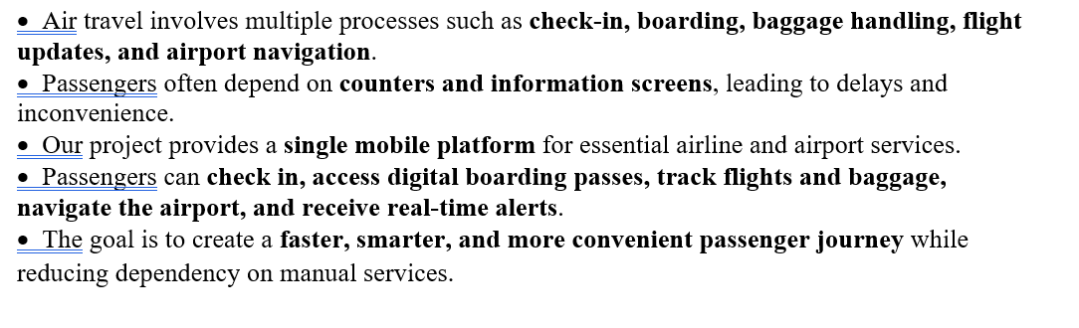
INTRDOUCTION

Slide 5
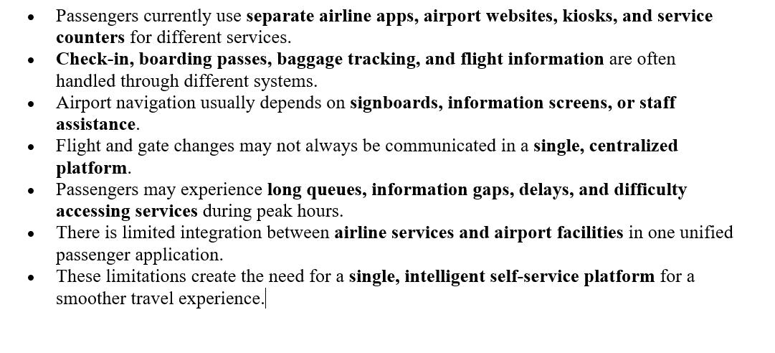
EXISTING SYSTEM

Slide 6
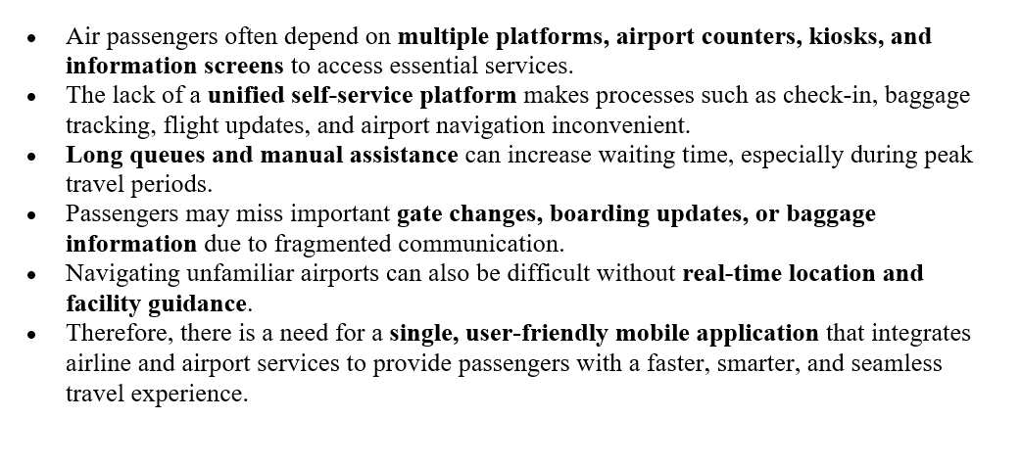
PROBLEM

Slide 7
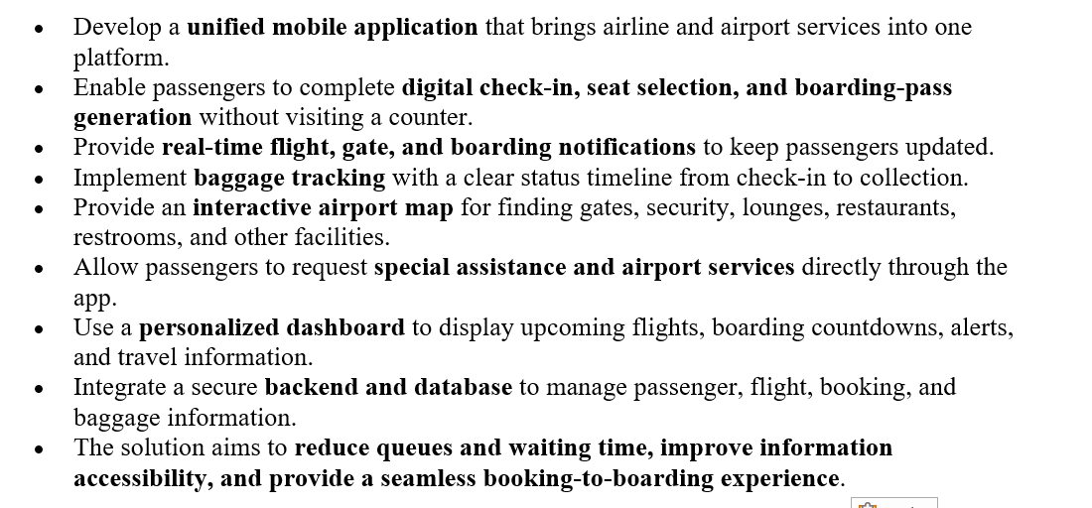
SOLUTION(Contribution)

Slide 8
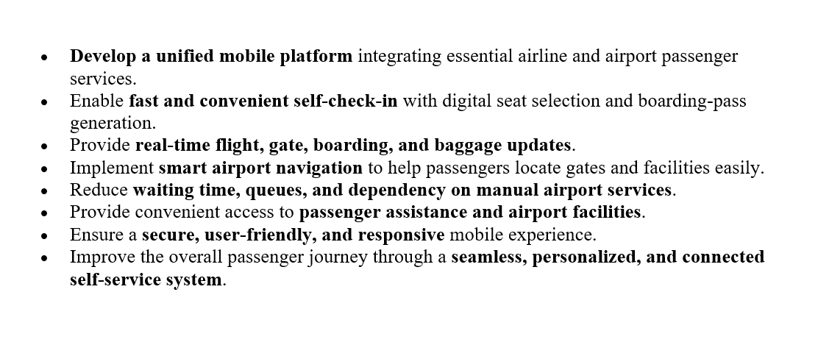
Objectives

Slide 9
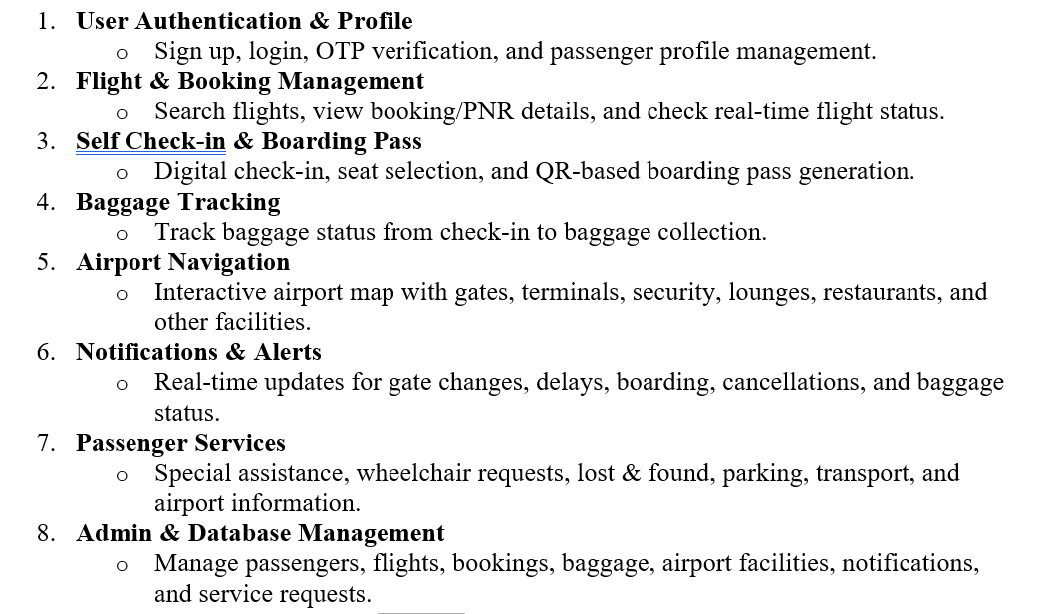
Modules

Slide 10
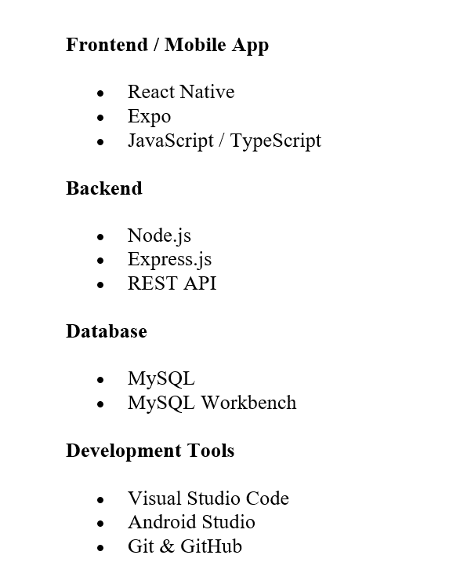
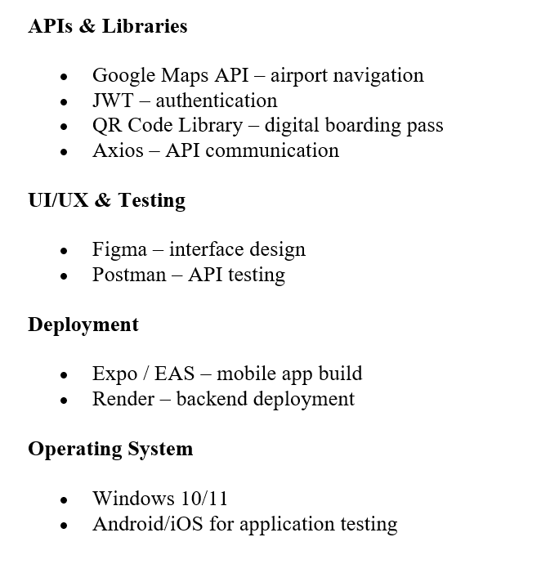
SOFTWARE REQUIREMENTS

Slide 11
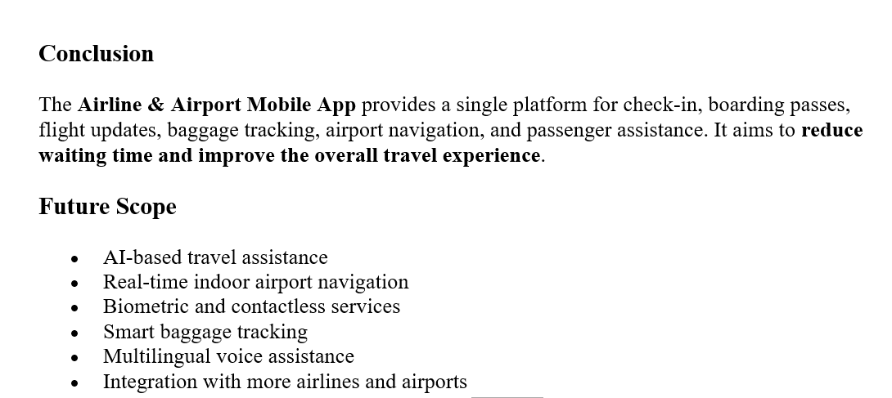
CONCLUSION AND FUTURE SCOPE

Slide 12
THANK YOU

